Slide 1
DV 369 Living Infrastructure in Residential Zones
Very important variation because of the impact it will have on the character of residential zones in the ACT.
This is a great opportunity to improve the current situation where the residential zones are being covered by more and more impervious surfaces.
GNCA is supportive of the goal of the variation, but the current draft can and should be modified.
A quick look at the status quo
A new suburb:
Ngunnawal

Slide 2
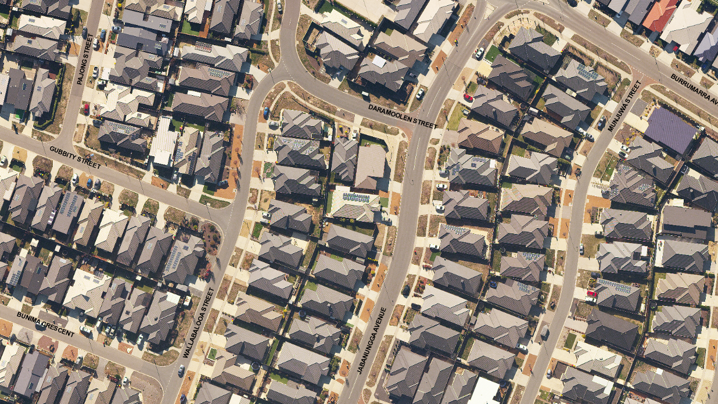

Slide 3
DV 369 Living Infrastructure in Residential Zones
Very important variation because of the impact it will have on the character of Residential Zones
This is a great opportunity to improve the current situation where the residential zones are being covered by more and more impervious surfaces.
Or an old suburb, Griffith impacted by Mr Fluffy redevelopment.

Slide 4
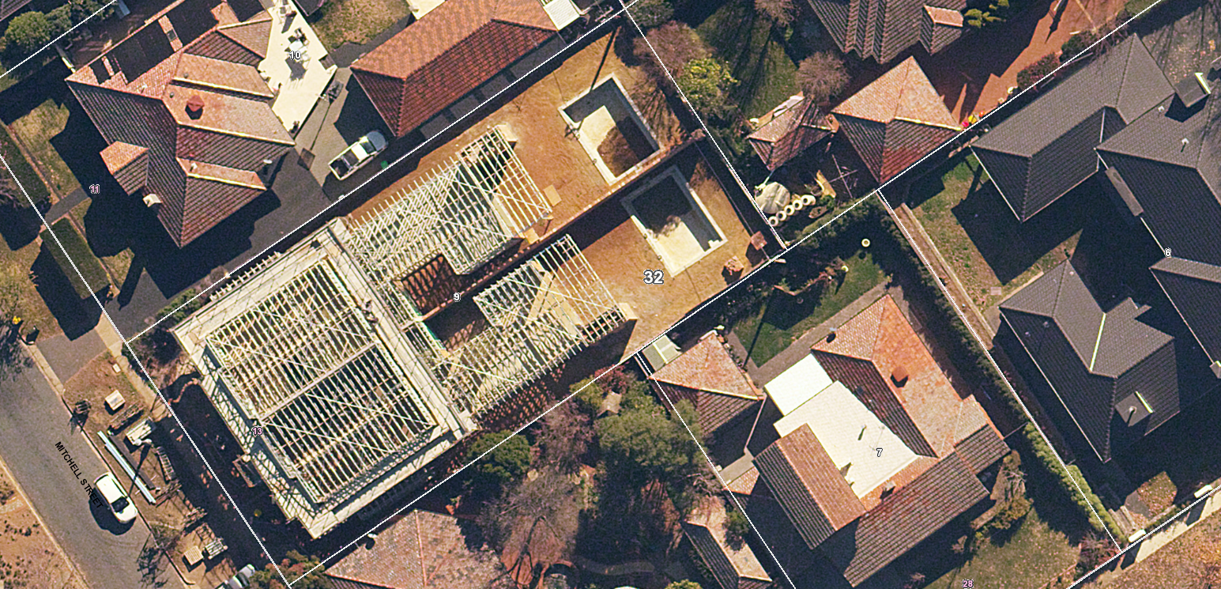

Slide 5
DV 369 Living Infrastructure in Residential Zones
Very important variation because of the impact it will have on the character of Residential Zones
This is a great opportunity to improve the current situation where the residential zones are being covered by more and more impervious surfaces.
In both these examples the dwellings comply with the planning rules!!

Slide 6
DV 369 Living Infrastructure in Residential Zones
What we need in DV 369
Planting Area Rules that are Mandatory and specify the percentage of the block to be covered.
Simple Rules for each zone that are easy to understand and what has to be done to comply with the rules.
The Criteria are well written, but a builder or a developer really wants something simpler. They explain very well the reasons for the rules.
To know why the 30% was adopted. Why not 40% or 35%?
5. To know the algorithm used to calculate the 30% (or 40%) tree canopy cover (or equivalent) and 30% (or 40% ) permeable surfaces in urban areas, so we know what we have to do to reach our goal.
7. Why not have the same % rule for each zone?
8. The current Plot Ratio Rule, which is mandatory, is not working, not needed and should be removed from the planning rules.

